Slide 1
Introduction to Sustainable Finance
UN CC e-Learn
Yang Xi’s study note, 2023

Slide 2
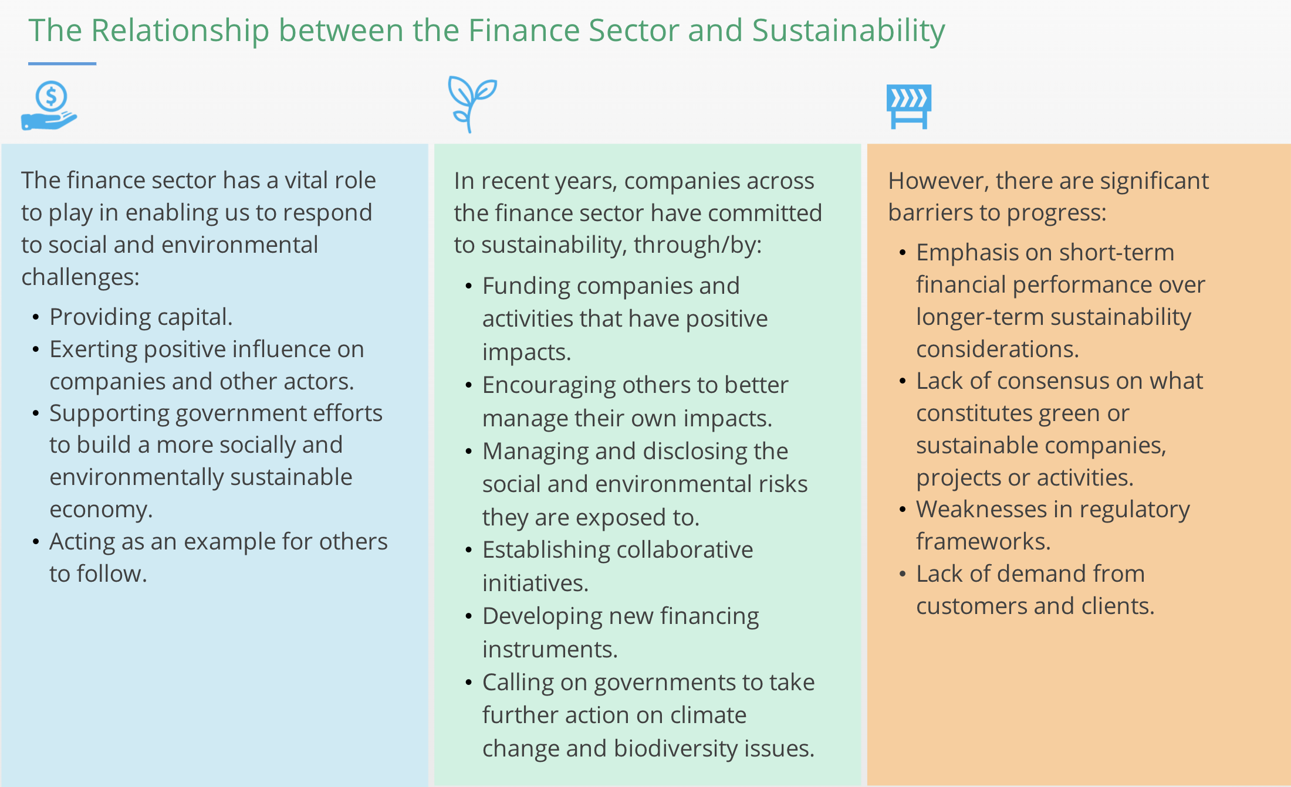

Slide 3
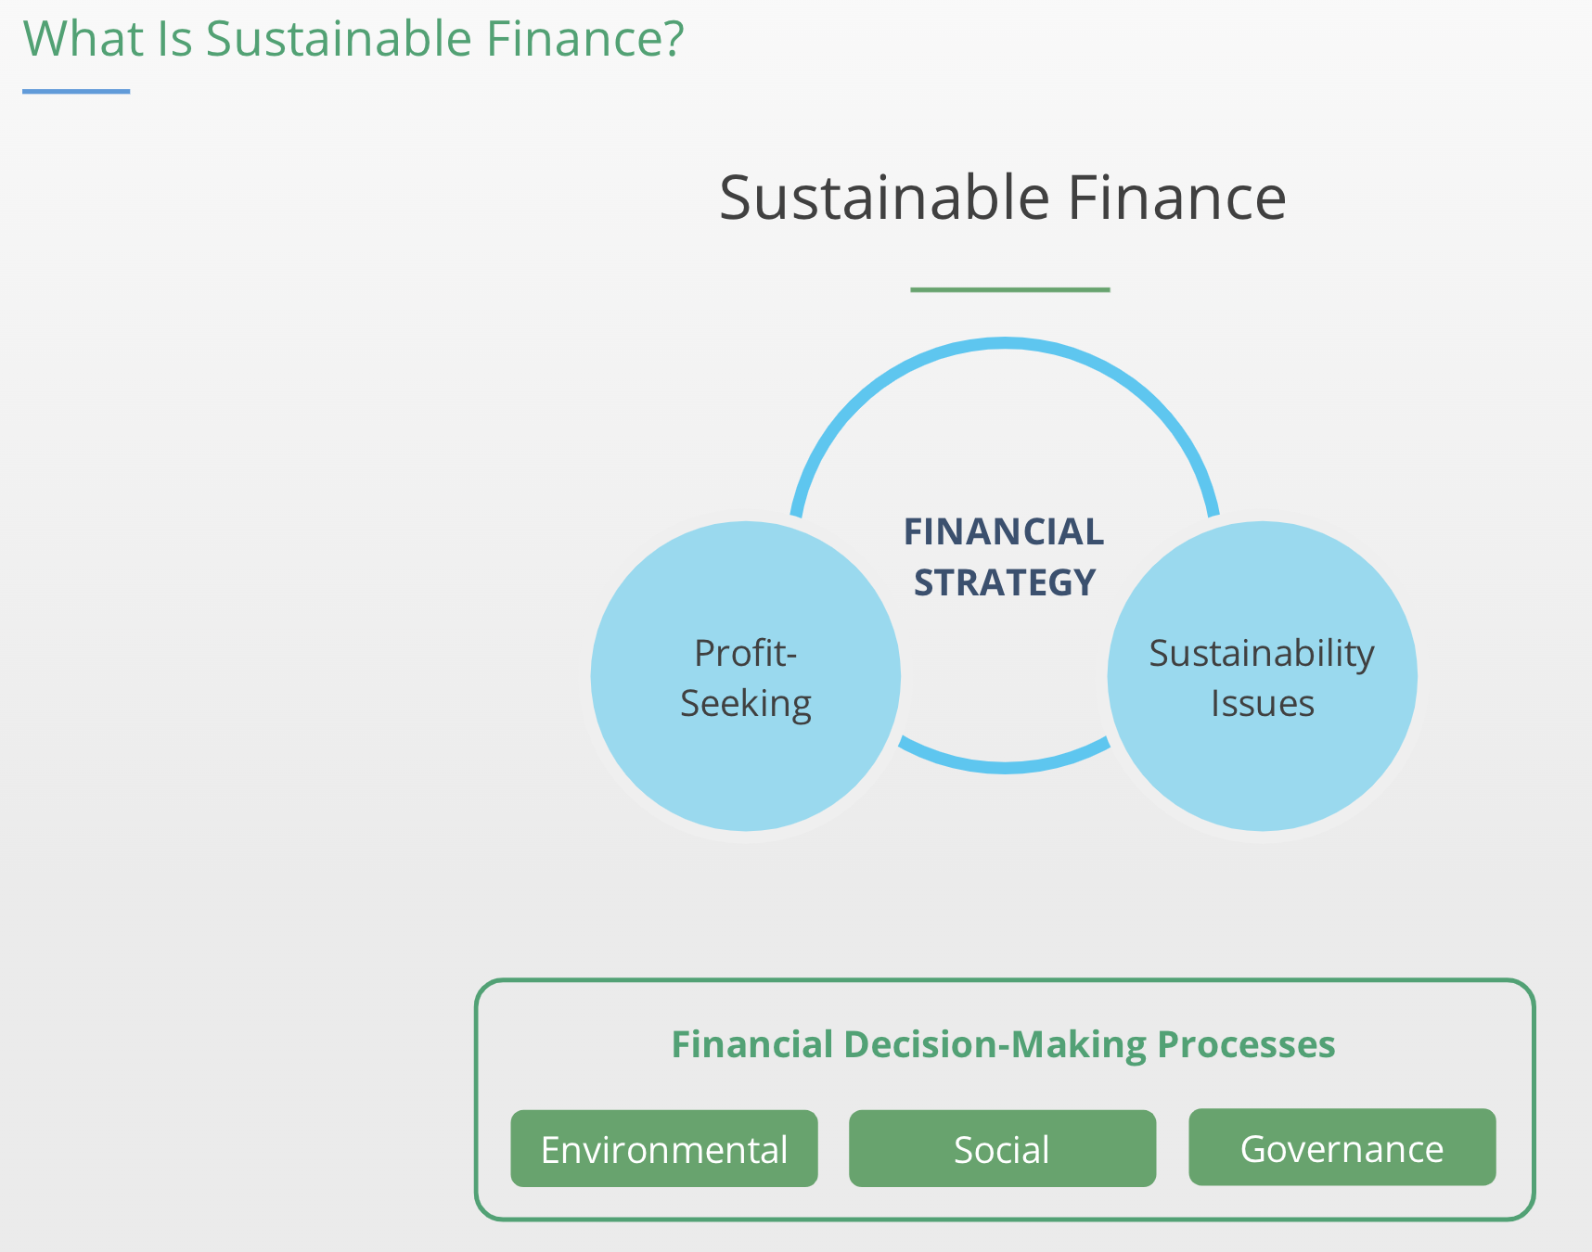
Sustainable Finance is about the alignment of the financial system with sustainability.
This course has a focus on private sectors

Slide 4
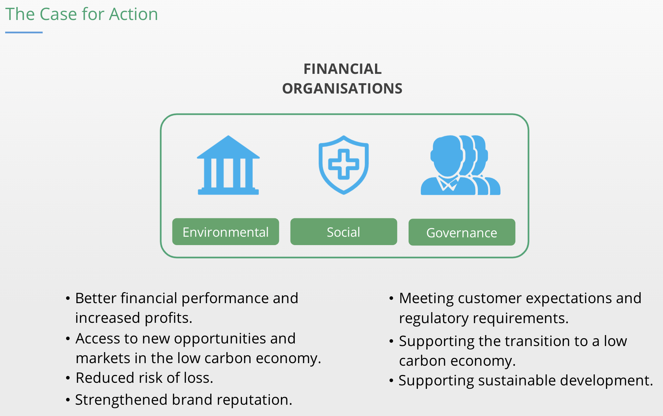
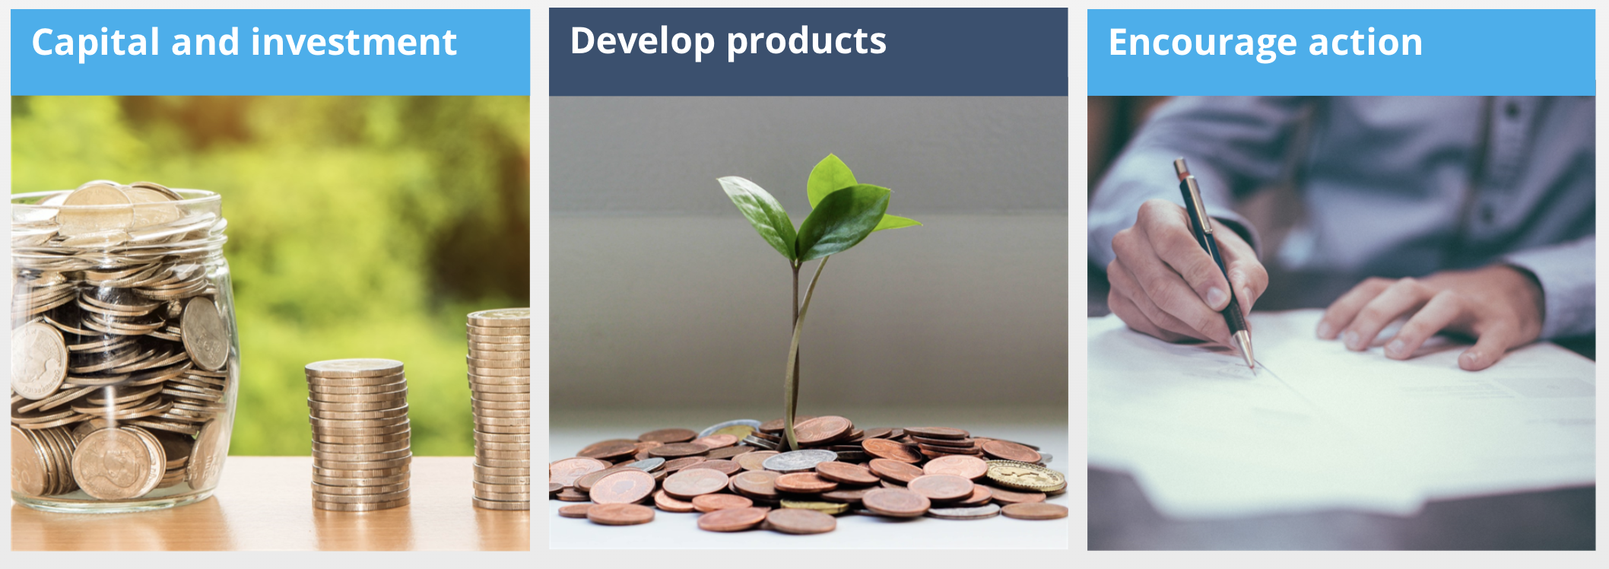

Slide 5
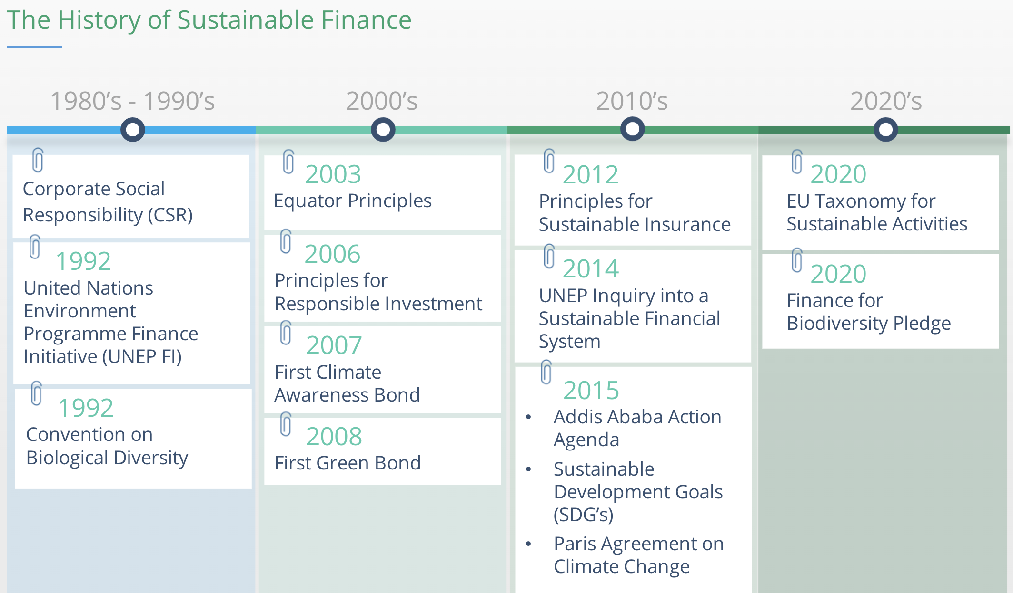
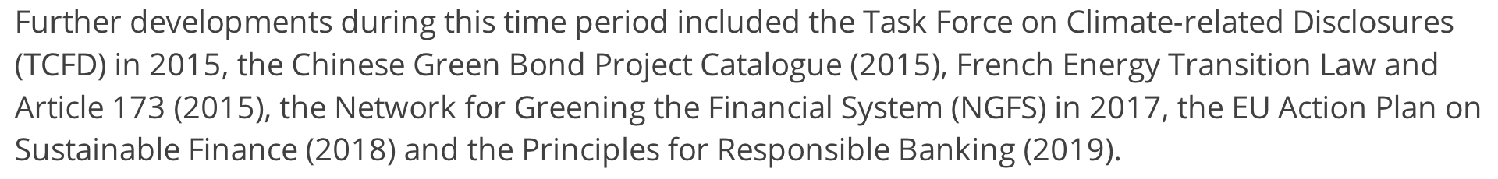
By EIB
Green Bond Principles (GBP) – 2014
2030 Agenda for Sustainable Development - 2015

Slide 6
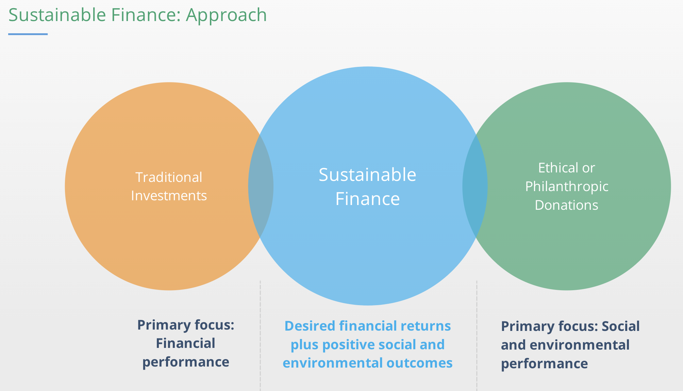

Slide 7
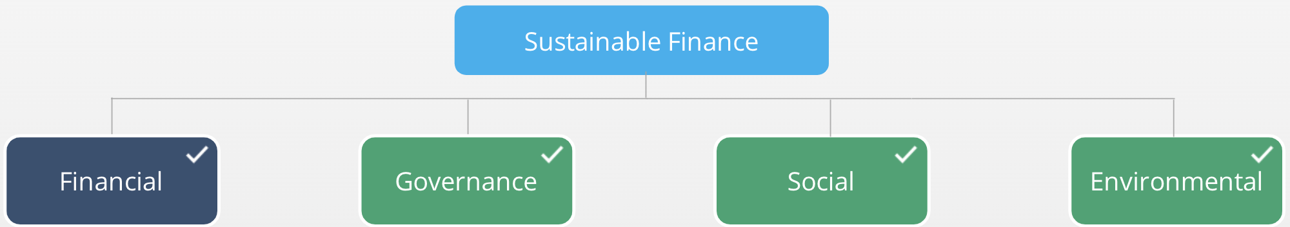
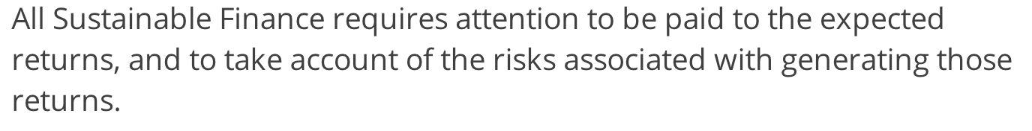
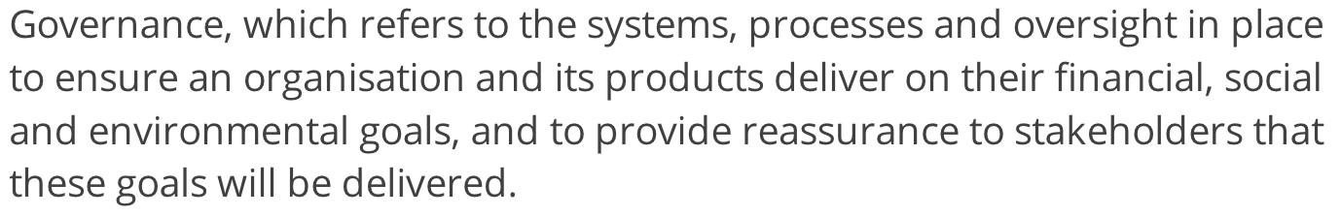
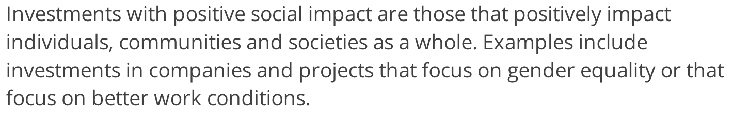
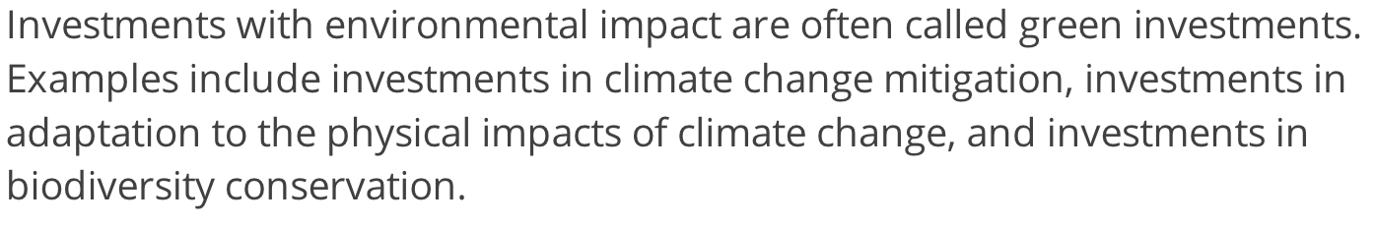

Slide 8
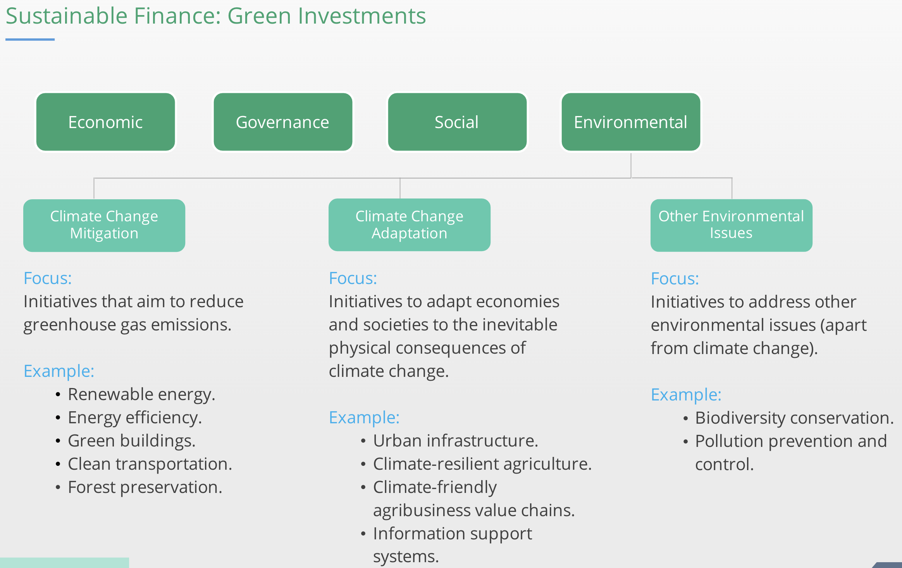

Slide 9
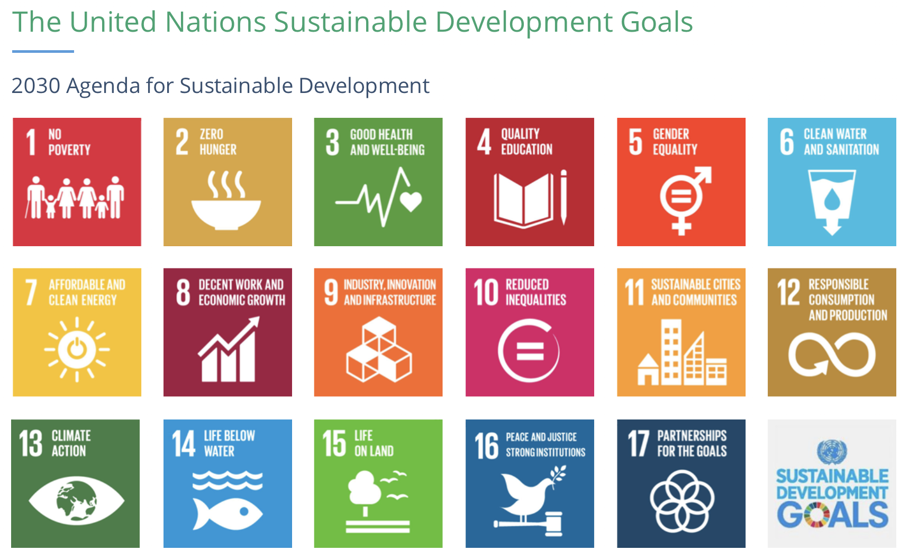

17 goals and 169 targets
https://youtu.be/5G0ndS3uRdo

Slide 10
The Paris Agreement
The Paris Agreement is a legally binding international UN treaty under the UNFCCC, agreed by 196 countries in Dec 2015
Aim to keep global warming well below 2°C, preferably to 1.5 °C compared to pre-industrial (1850-1900) levels.
It works on 5-year cycles of increasingly ambitious climate action
By 2020 – nationally determined contributions and actions
By 2024 – countries to report transparently on actions taken
https://youtu.be/WiGD0OgK2ug
As of now, if all nationally determined (in 2020) contributions and actions are fulfilled, it will only keep global warming between 2°C to 4°C

Slide 11
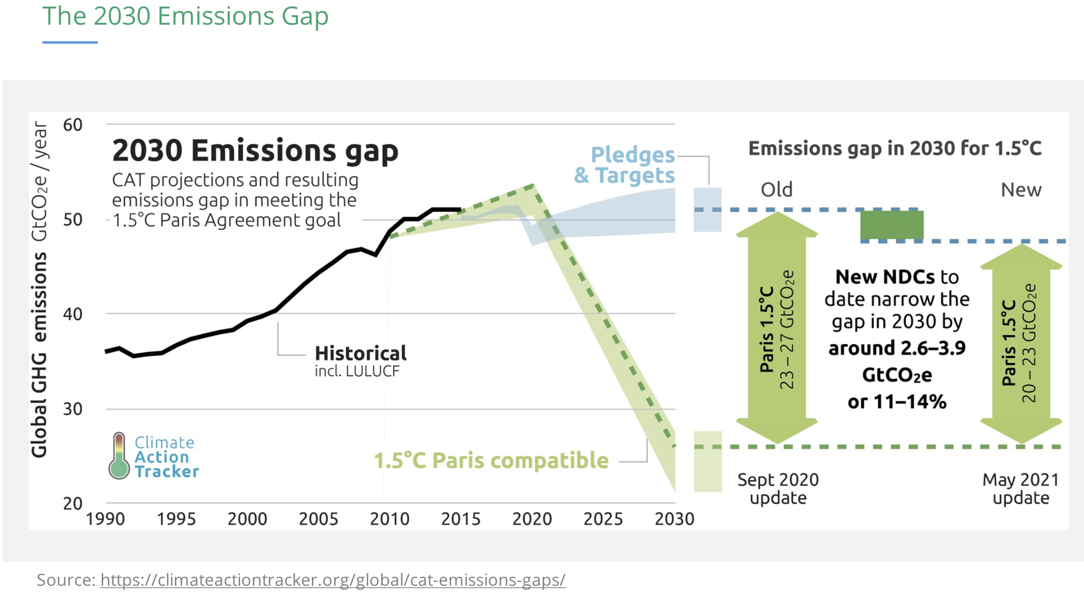

Slide 12
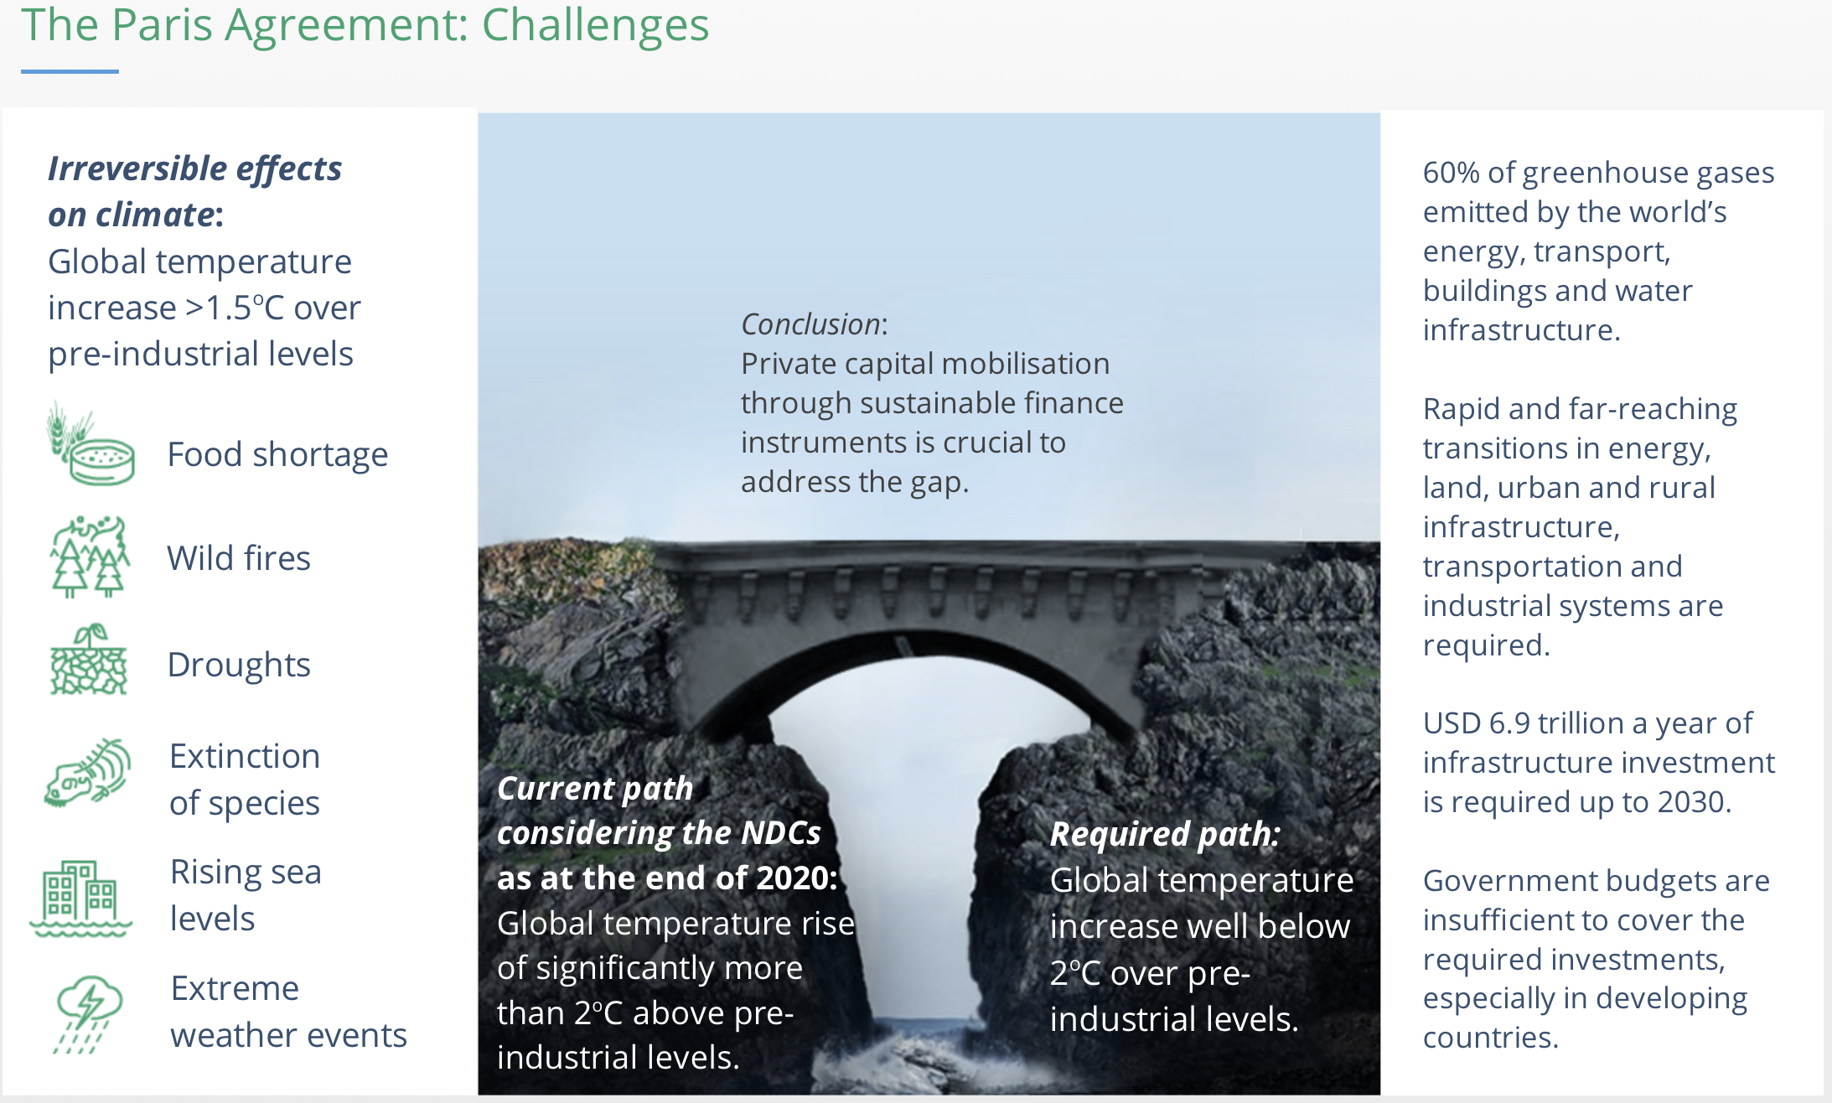

Slide 13
